Slide 1
Software Engineering :
9 : Software Architecture Part 2
Professor Imed Bouchrika National School of Artificial Intelligence imed.bouchrika@ensia.edu.dz

Slide 2
Outline :
Part 1:
Introduction to Software Architecture
Software Architecture Process
Selecting Technological Stack
Architecture Quality Attributes
Software Architectural Styles
Part 2 :
Programming Questions
Design Patterns
Architecture Principles : SOLID
Part 3 :
Decoupling & Cohesion
Documenting the Architecture
Case Study

Slide 3
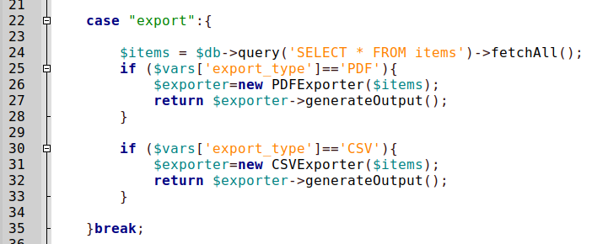
Design Patterns in OOP : Why Important
Design Patterns : Clean Code but Architectural Violations
Case 1 : Exporting To-Do Items to PDF and CSV

Slide 4
Design Patterns in OOP : Why Important
Design Patterns : Clean Code but Architectural Violations
Case 1 : Exporting To-Do Items to PDF and CSV
“New” is made similar to Glue in software engineering

Slide 5
Design Patterns in OOP : Why Important
Design Patterns : Clean Code but Architectural Violations
Case 1 : Exporting To-Do Items to PDF and CSV
How to add EXCEL format without changing the original code ?

Slide 6
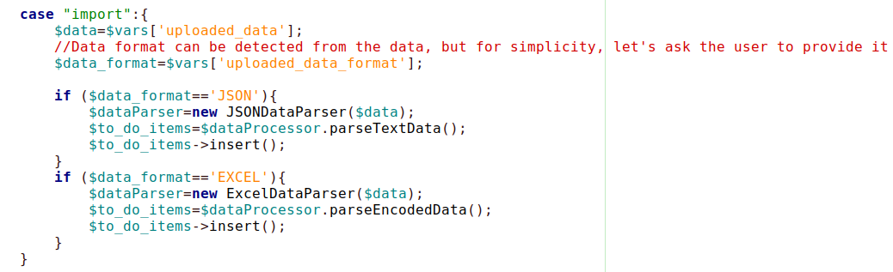
Design Patterns in OOP : Why Important
Design Patterns : Clean Code but Architectural Violations
Case : Importing data with different formats

Slide 7
Design Patterns in OOP : Why Important
Design Patterns : Clean Code but Architectural Violations
Case : Importing data with different formats
What happens if we want to support other formats ? JSON ? XML ?

Slide 8
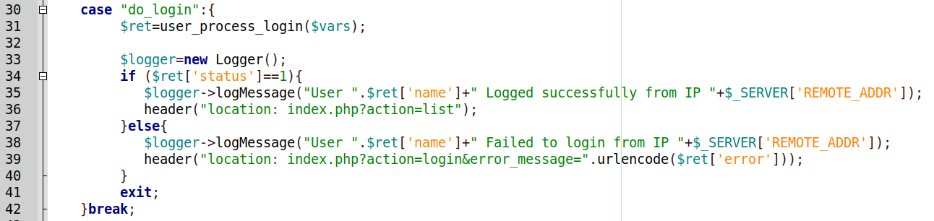
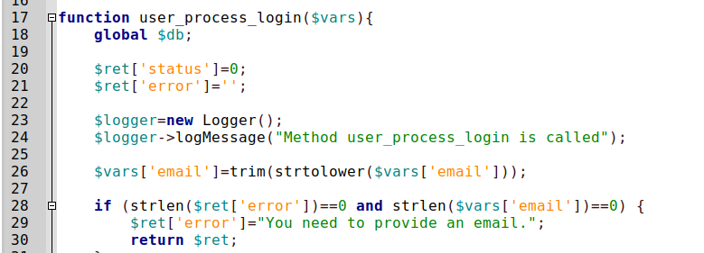
Design Patterns in OOP : Why Important
Design Patterns : Clean Code but Architectural Violations
Case 3 :Logger for Logging Messages…

Slide 9
Design Patterns in OOP : Why Important
Design Patterns : Clean Code but Architectural Violations
Case 4 : Implement the undo features with a history of 5 actions applied to the to-do items.
Example :
Add item
Edit Item
Mark item done
Delete Item
Mark Item as not done.

Slide 10
Design Patterns in OOP : Why Important
Design Patterns : Clean Code but Architectural Violations
Case 4 : Implement the undo features with a history of 5 actions applied to the to-do items.
Example :
Add item
Edit Item
Mark item done
Delete Item
Mark Item as not done.
Using Procedural Programming : It is virtually impossible unless you make another mess with the code

Slide 11
Design Patterns in OOP : Why Important
Design Patterns : Clean Code but Architectural Violations
Case 4 : Implement the undo features with a history of 5 actions applied to the to-do items
Example :
Add item
Edit Item
Mark item done
Delete Item
Mark Item as not done.
Design Patterns are solutions for common problems

Slide 12
Design Patterns in OOP : Why Important
Design Patterns : Clean Code + Architectural Best Practices
Importance of OOP and Design Patterns
The To-Do as a Case-Study:
Programmers are hasty to implement the functional features
There will be always refactoring to improve and add new features.
But, the lack of OOP + Design patterns can make the following impossible: Refactoring, extension and maintenance.

Slide 13
Design Patterns in OOP : Why Important
Design Patterns : Definition
A collection of general, re-usable solutions to common problems in software design and implementation at the low-level.
Considered patterns at the micro-architecture.
Why Use design patterns:
Tested and used by the brightest developers in the industry.
Makes the code more flexible, readable and maintainable.
Introduced in 1987 by Erich Gamma et al.

Slide 14
Design Patterns : Factory Pattern
Factory Pattern : Definition
Extremely popular, Allows creating objects without :
Specifying the exact class of the object inside the main code.
Any other business logic when creating an object ( Like setting attrs)
Opposite :

Slide 15
Design Patterns : Factory Pattern
Factory Pattern : Why ?
Avoid strong coupling between classes :
Main class is coupled (glued) with two more classes ( PDFExporter + CSV Exporter)

Slide 16
Design Patterns : Factory Pattern
Factory Pattern : Why ?
Improve the extensibility :
In the shown code, you have modify the original code extensively + RETEST + Redeploy

Slide 17
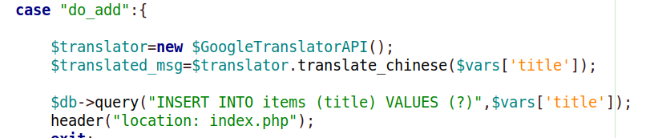
Design Patterns : Factory Pattern
Factory Pattern : Why ?
Improve the maintenance :
In the shown code, suppose that Google stopped working for you, you need to move to use OpenAI API instead :

Slide 18
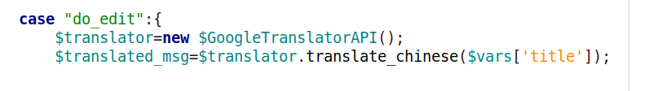
Design Patterns : Factory Pattern
You have to go through ALL Files where there is new GoogleTranslateAPI and replace with new OpenAIAPITranslation();
Factory Pattern : Why ?
Improve the maintenance :
In the shown code, suppose that Google stopped working for you, you need to move to use OpenAI API instead :

Slide 19
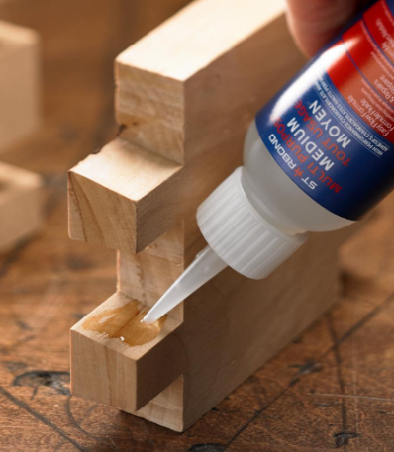
Design Patterns : Factory Pattern
Factory Pattern : Why ?
Improve the maintenance :
In the shown code, suppose that Google stopped working for you, you need to move to use OpenAI API instead :
Whenever there is the word new, it is glue ⇒ The classes are glued together

Slide 20
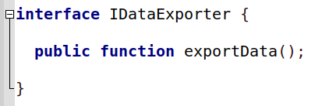
Design Patterns : Factory Pattern
Factory Pattern : How ?
Create an interface (or even abstract class) to represent various instances, It needs to contain:
The common method(s) to be called.
01

Slide 21
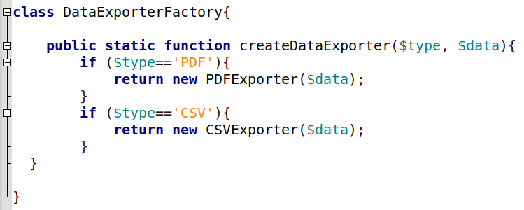
Design Patterns : Factory Pattern
Factory Pattern : How ?
Create the Factory class (You may optionally create an interface for it)
The class needs to contain the method createDataExporter
02

Slide 22

Design Patterns : Factory Pattern
Factory Pattern : How ?
Inside the main file, no need to know at all about the real class. No need to glue any class.
03

Slide 23
Design Patterns : Factory Pattern
Factory Pattern : How ?
Inside the main file, no need to know at all about the real class. No need to glue any class.
03

Slide 24

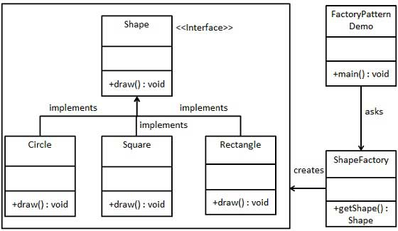
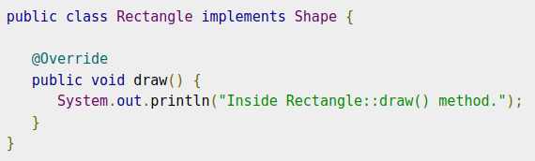
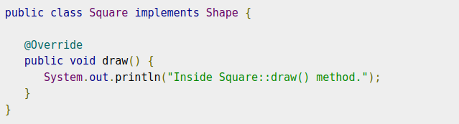
Design Patterns : Factory Pattern
Factory Pattern : Shapes Examples using Examples:

Slide 25
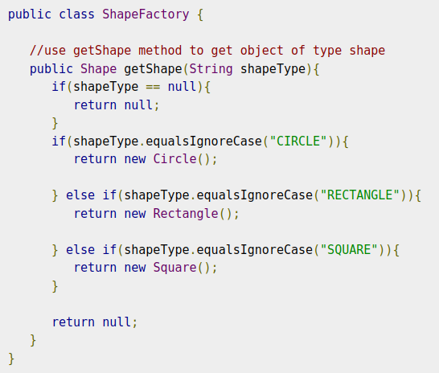
Design Patterns : Factory Pattern
Factory Pattern : Shapes Examples using Examples:

Slide 26
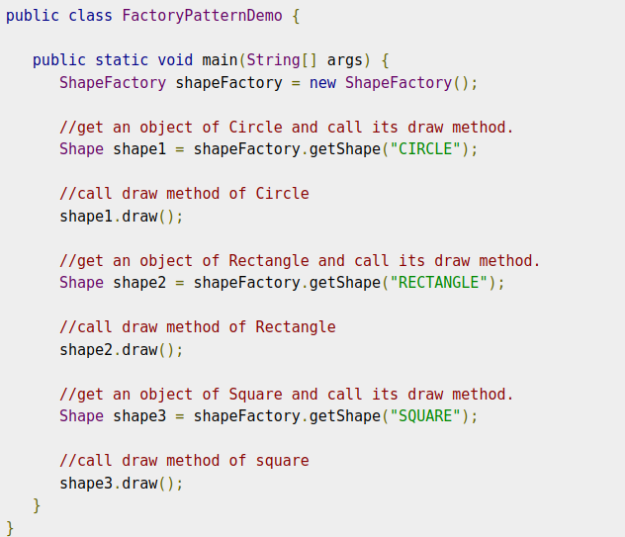
Design Patterns : Factory Pattern
Factory Pattern : Shapes Examples using Examples:
Example taken from : https://www.tutorialspoint.com/design_pattern/factory_pattern.htm

Slide 27
Design Patterns : Singleton Pattern
Singleton Pattern : Definition
It is the simplest pattern
Responsible for creating an object whilst ensuring that only one instance of the object is running at the same time.

Slide 28
Design Patterns : Singleton Pattern
Do we need to create an instance of the Logger or Database object every time we need to call one of its method ?
Singleton Pattern : Definition
It is the simplest pattern
Responsible for creating an object whilst ensuring that only one instance of the object is running at the same time.

Slide 29
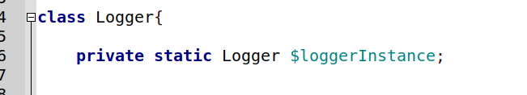

Design Patterns : Singleton Pattern
Singleton Pattern : Why
With the class to be used and instantiated once:
Create a static variable of the same type as the object.
01

Slide 30
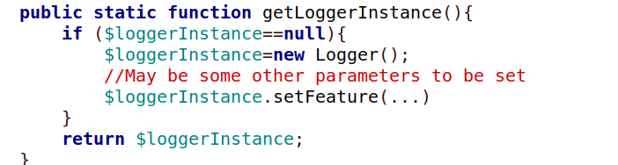
Design Patterns : Singleton Pattern
Singleton Pattern : How
With the class to be used and instantiated once:
Create a static function to either :
Create a new instance if does not exist
Return the already created instance if it does exist.
02

Slide 31

Design Patterns : Singleton Pattern
Singleton Pattern : How
Everytime the logger is needed, the newly created method is invoked.
03

Slide 32
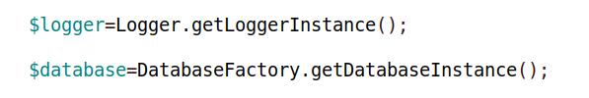
Design Patterns : Singleton Pattern
Singleton Pattern : Refactoring To-Do
Everytime the logger is needed, the newly created method is invoked.
03

Slide 33
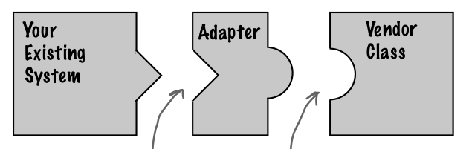
Design Patterns : Adapter Pattern
Adapter Pattern : Definition
Structural design pattern that allows objects with incompatible interfaces to collaborate
The adapter acts as the middleman by receiving requests from the client and converting them into requests that make sense on the vendor classes.

Slide 34
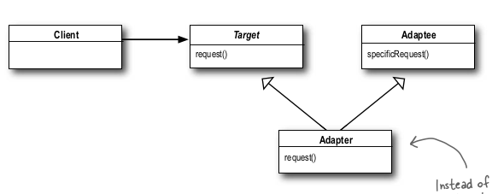
Design Patterns : Adapter Pattern
Adapter Pattern : Definition
The client makes a request to the adapter by calling a method on it using the target interface.
The adapter translates the request into one or more calls on the adaptee using the adaptee interface.
The client receives the results of the call and never knows there is an adapter doing the translation.

Slide 35
Design Patterns : Adapter Pattern
Adapter Pattern : Definition
The client makes a request to the adapter by calling a method on it using the target interface.
The adapter translates the request into one or more calls on the adaptee using the adaptee interface.
The client receives the results of the call and never knows there is an adapter doing the translation.
The Adapter Pattern’s role is to convert one interface into another

Slide 36
Design Patterns : Adapter Pattern
Adapter Pattern : Why
To facilitate integration with non-compatible libraries and classes.

Slide 37
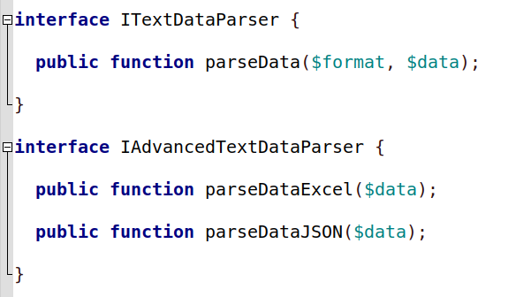
Design Patterns : Adapter Pattern
Adapter Pattern : How
Let’s define the two interfaces
01

Slide 38
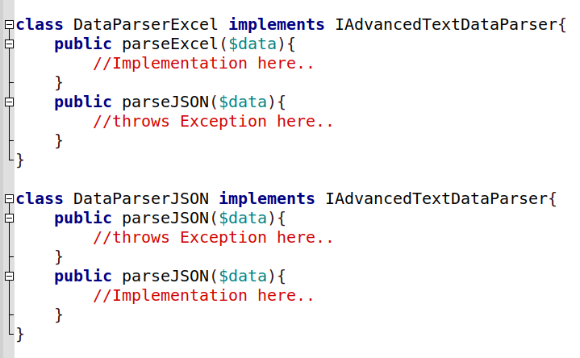
Design Patterns : Adapter Pattern
Adapter Pattern : How
Implement the adaptee(s)
02

Slide 39
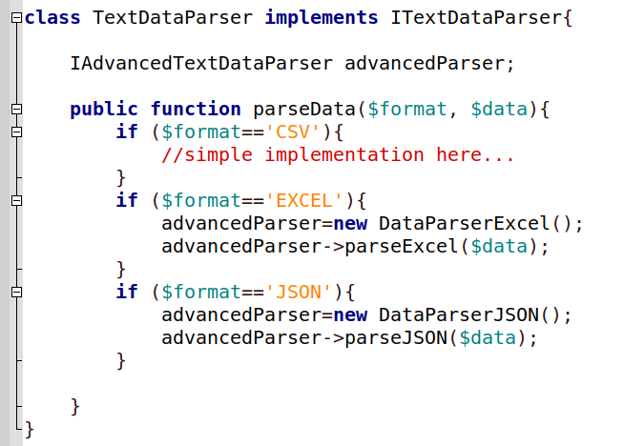
Design Patterns : Adapter Pattern
Adapter Pattern : How
Creating the Adapter Class
03

Slide 40
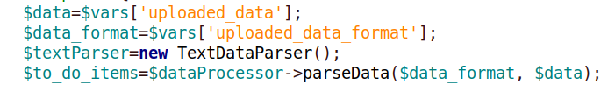
Design Patterns : Adapter Pattern
Adapter Pattern : How
Integrate with the main code
04

Slide 41
Design Patterns : Adapter Pattern
Adapter Pattern : How
Integrate with the main code
04
Can you re-use the old code in other projects ?

Slide 42
Design Patterns : Command Pattern
Command Pattern : Definition
Less used.
Easy to implement
Encapsulate Invocation or execution by unifying the way we invoke different objects.

Slide 43
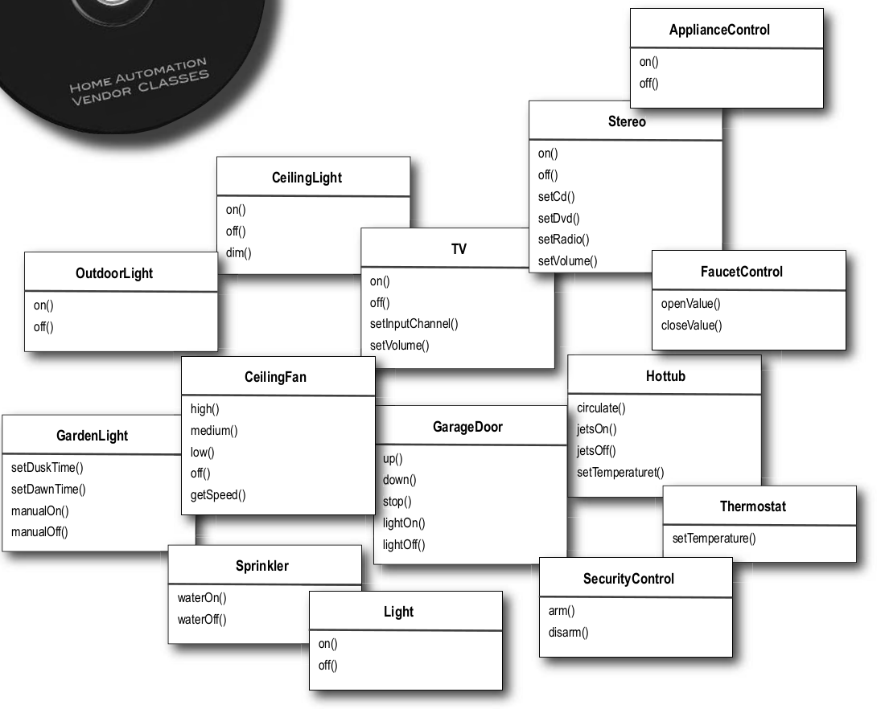
Design Patterns : Command Pattern
Command Pattern : Why
Simplify, Unify and Facilitate Automation

Slide 44
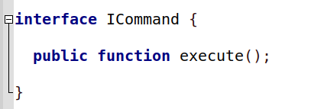
Design Patterns : Command Pattern
Command Pattern : How
Propose an Interface with the name ICommand and a method execute( )
01

Slide 45
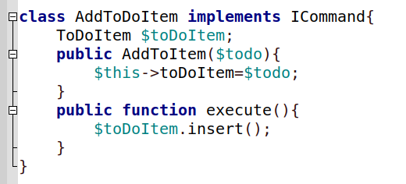
Design Patterns : Command Pattern
Command Pattern : How
For each Action that you want to encapsulate its invocation, you need to create a class which implements the ICommand interface
02

Slide 46
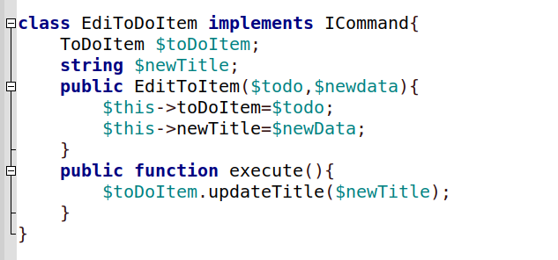
Design Patterns : Command Pattern
Command Pattern : How
For each Action that you want to encapsulate its invocation, you need to create a class which implements the ICommand interface
02

Slide 47
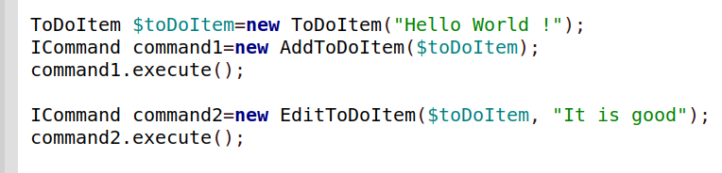
Design Patterns : Command Pattern
Command Pattern : How
Start to invoke commands :
03

Slide 48
Design Patterns : Command Pattern
How to implement the Undo Feature ?
Command Pattern : How
Start to invoke commands :
03

Slide 49
Design Patterns : Facade Pattern
Facade Pattern : Definition
Creating a layer of abstraction to mask complex actions
Example :
Transfer money
Make sure accounts exist
Make sure the first account has enough money
Withdraw money from first account
Deposit money in second account
Add event in account log

Slide 50
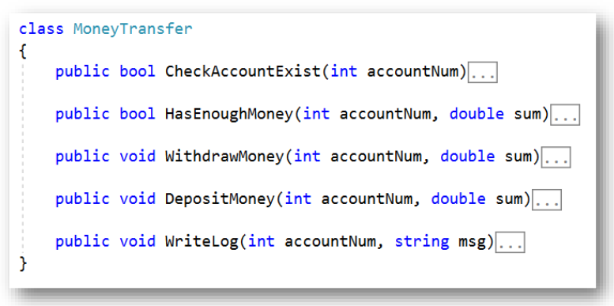
Design Patterns : Facade Pattern
Facade Pattern : Definition
Creating a layer of abstraction to mask complex actions
Example :
Transfer money
Make sure accounts exist
Make sure the first account has enough money
Withdraw money from first account
Deposit money in second account
Add event in account log

Slide 51
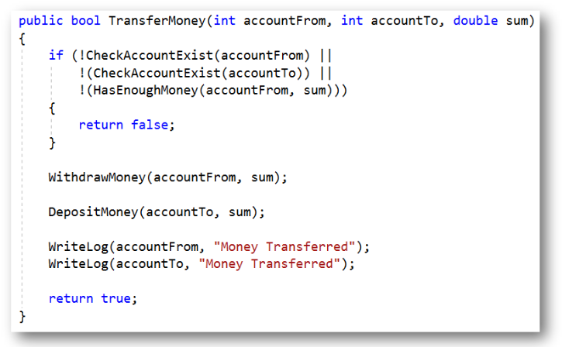
Design Patterns : Facade Pattern
Facade Pattern : Definition
Creating a layer of abstraction to mask complex actions
Example :
Transfer money
Make sure accounts exist
Make sure the first account has enough money
Withdraw money from first account
Deposit money in second account
Add event in account log

Slide 52


Design Patterns : Repository Pattern
Repository Pattern : Definition
We have discovered an error in the naming of our database table to be corrected to : todo_items instead of items

Slide 53
Design Patterns : Repository Pattern
Tedious process
Prone to Errors + How many files we are going to change ?
Repository Pattern : Definition
We have discovered an error in the naming of our database table to be corrected to : todo_items instead of items

Slide 54
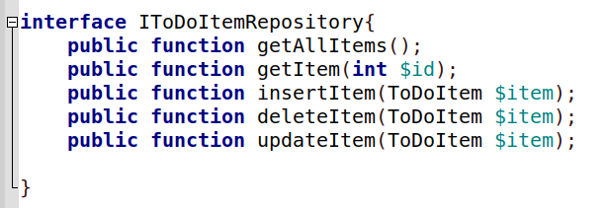
Design Patterns : Repository Pattern
Repository Pattern : How

Slide 55
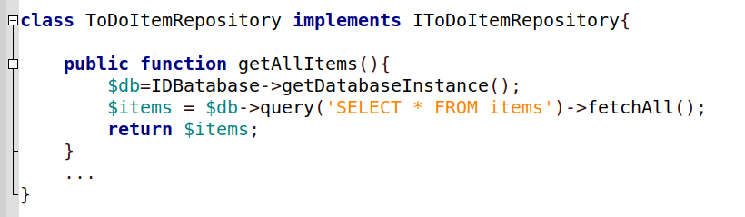
Design Patterns : Repository Pattern
Repository Pattern : How

Slide 56
Design Patterns : Other patterns
There are more patterns including:
Bridge
Builder
Prototype
Filter
Decorator
Proxy
Flyweight
Interpreter
…

Slide 57
Best Practices : SOLID
SOLID Practices
Most important acronym in the software industry
Coined by Bob Martin in 2000 in his book : Clean Code
Aimed to represent the five principles when implemented, it makes the code :
Easy to read and understand
Maintainable
Flexible to extend

Slide 58
Best Practices : SOLID
SOLID Practices
S : Single Responsibility Principle
O : Open/Closed Principles
L : Liskov Substitution Principle
I : Interface Segregation Principle
D : Dependency Inversion Principle

Slide 59
Best Practices : SOLID
SOLID Practices : S = Single Responsibility Principle
Definition :
Each class ( or method) should have only one sole purpose and not be filled with excessive functionalities
In other words: Each class, module, or method should have one and only one responsibility
THEREFORE : A class should have one and only one reason to change.

Slide 60
Best Practices : SOLID
SOLID Practices : S = Single Responsibility Principle
Example :
Logging Engine :
Usually done in a single method using low-level instructions
How the message should be formatted
Where the message should be written
But
Two Classes should be created to handle the two responsibilities

Slide 61
Best Practices : SOLID
If there is a change, it will affect only a well defined class/module/method without looking into other obscure places.
SOLID Practices : S = Single Responsibility Principle
Example :
Logging Engine :
Usually done in a single method using low-level instructions
How the message should be formatted
Where the message should be written
But
Two Classes should be created to handle the two responsibilities

Slide 62
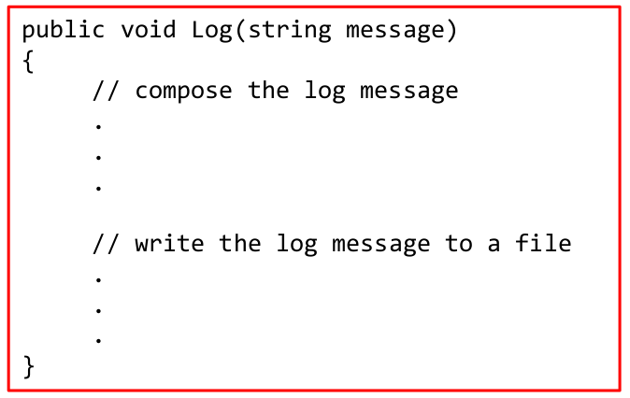
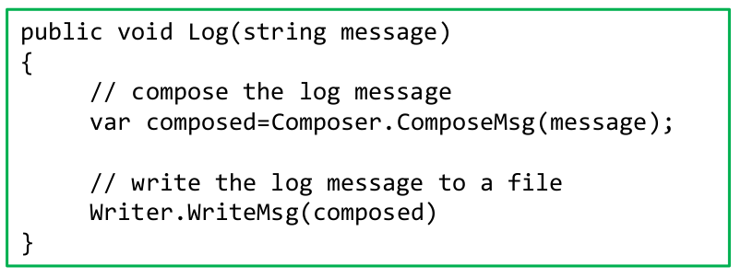
Best Practices : SOLID
SOLID Practices : S = Single Responsibility Principle
← This method is an instance method of ToDoItem

Slide 63
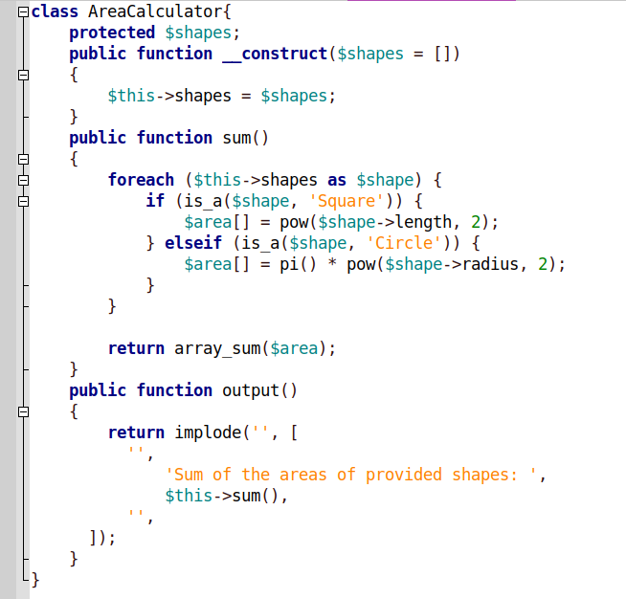
Best Practices : SOLID
SOLID Practices : S = Single Responsibility Principle
Example (PHP)

Slide 64
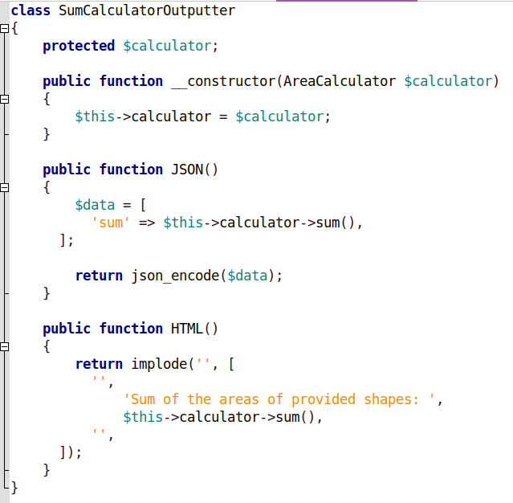
Best Practices : SOLID
SOLID Practices : S = Single Responsibility Principle
Example (PHP)

Slide 65
Best Practices : SOLID
SOLID Practices : O = Open/Closed Principles
Definition :
Classes should be open for extension but closed for modification of original code.
In other words, you should not have to rewrite an existing class for implementing new features.

Slide 66
Best Practices : SOLID
SOLID Practices : O = Open/Closed Principles
How :
Inheritance
Module/Plugin Mechanism

Slide 67
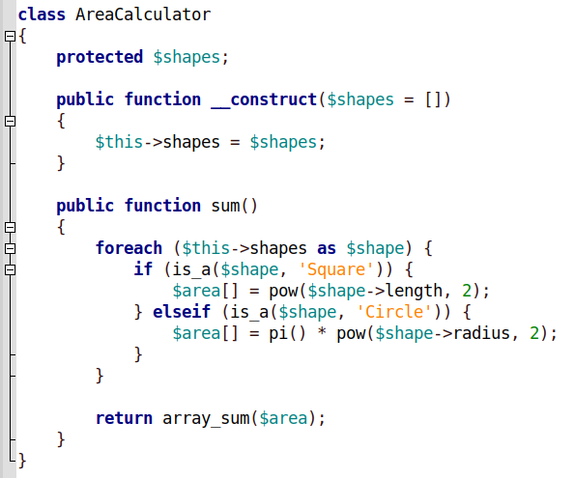
Best Practices : SOLID
SOLID Practices : O = Open/Closed Principles
Example :
If we add another shape (Rectangle) we need to get to main class and add another elseif

Slide 68
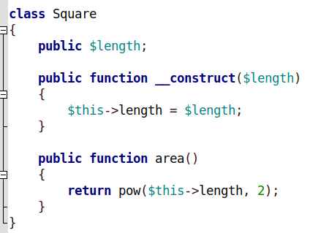
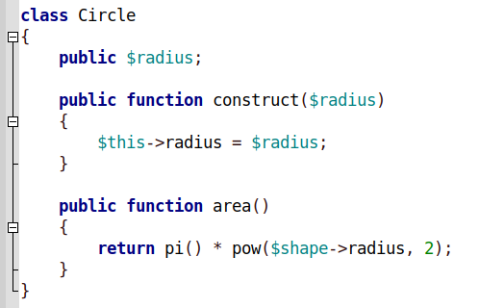
Best Practices : SOLID
SOLID Practices : O = Open/Closed Principles
Example :
If we add another shape (Rectangle) we need to get to main class and add another elseif

Slide 69
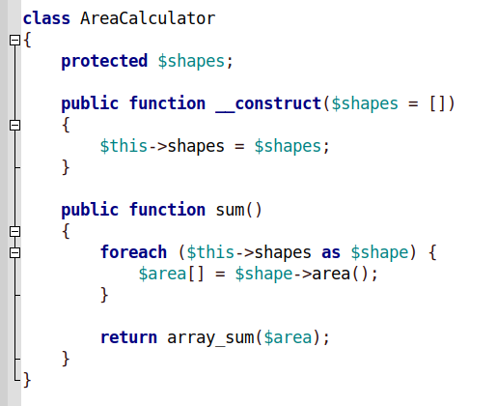
Best Practices : SOLID
SOLID Practices : O = Open/Closed Principles
Example :
If we add another shape (Rectangle) we need to get to main class and add another elseif

Slide 70
Best Practices : SOLID
SOLID Practices : L = Liskov Substitution Principle
Definition :
Every subclass or derived class should be substitutable for their base or parent class without changing the behavior.

Slide 71
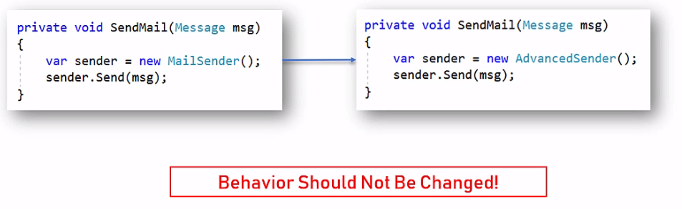
Best Practices : SOLID
SOLID Practices : L = Liskov Substitution Principle
Example :

Slide 72
Best Practices : SOLID
SOLID Practices : L = Liskov Substitution Principle
Example :
If the old sendmail sends an email only, the new advanced function should send an email only New features that change the behaviour : Throwing an exception ? Sending CC copy..

Slide 73
Best Practices : SOLID
SOLID Practices : L = Liskov Substitution Principle
Example :
Why : It can impact other components and debugging errors is extremely difficult.

Slide 74
Best Practices : SOLID
SOLID Practices : I = Interface Segregation Principle
Definition :
Interfaces should not force classes to implement what they cannot do.
Large interfaces should be divided into small ones.

Slide 75
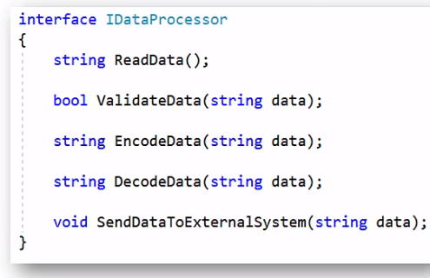
Best Practices : SOLID
SOLID Practices : I = Interface Segregation Principle
Example :

Slide 76
Best Practices : SOLID
If you are to implement this interface you are forced to implement all methods. Remember the Single Responsibility Principle
SOLID Practices : I = Interface Segregation Principle
Example :

Slide 77
Best Practices : SOLID
SOLID Practices : D = Dependency Inversion Principle
Definition :
Components should depend on abstractions not on concretions.
High-level module must not depend on the low-level module, but they should depend on abstractions.

Slide 78
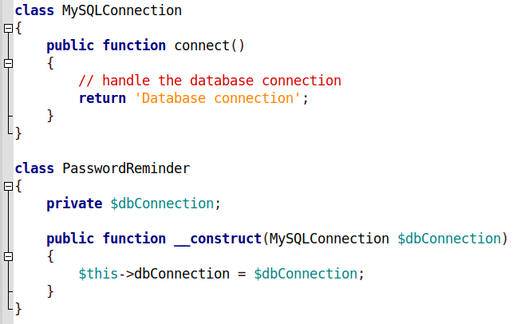
Best Practices : SOLID
SOLID Practices : D = Dependency Inversion Principle
Example :
The PasswordReminder should never depend on a low-level class ( MySQLConnection) , it should depend on an abstract class or interface

Slide 79
Next….
Cohesion
Decoupling
Documenting the Architecture
Case Study : To Do App or another App….

